Slide 1
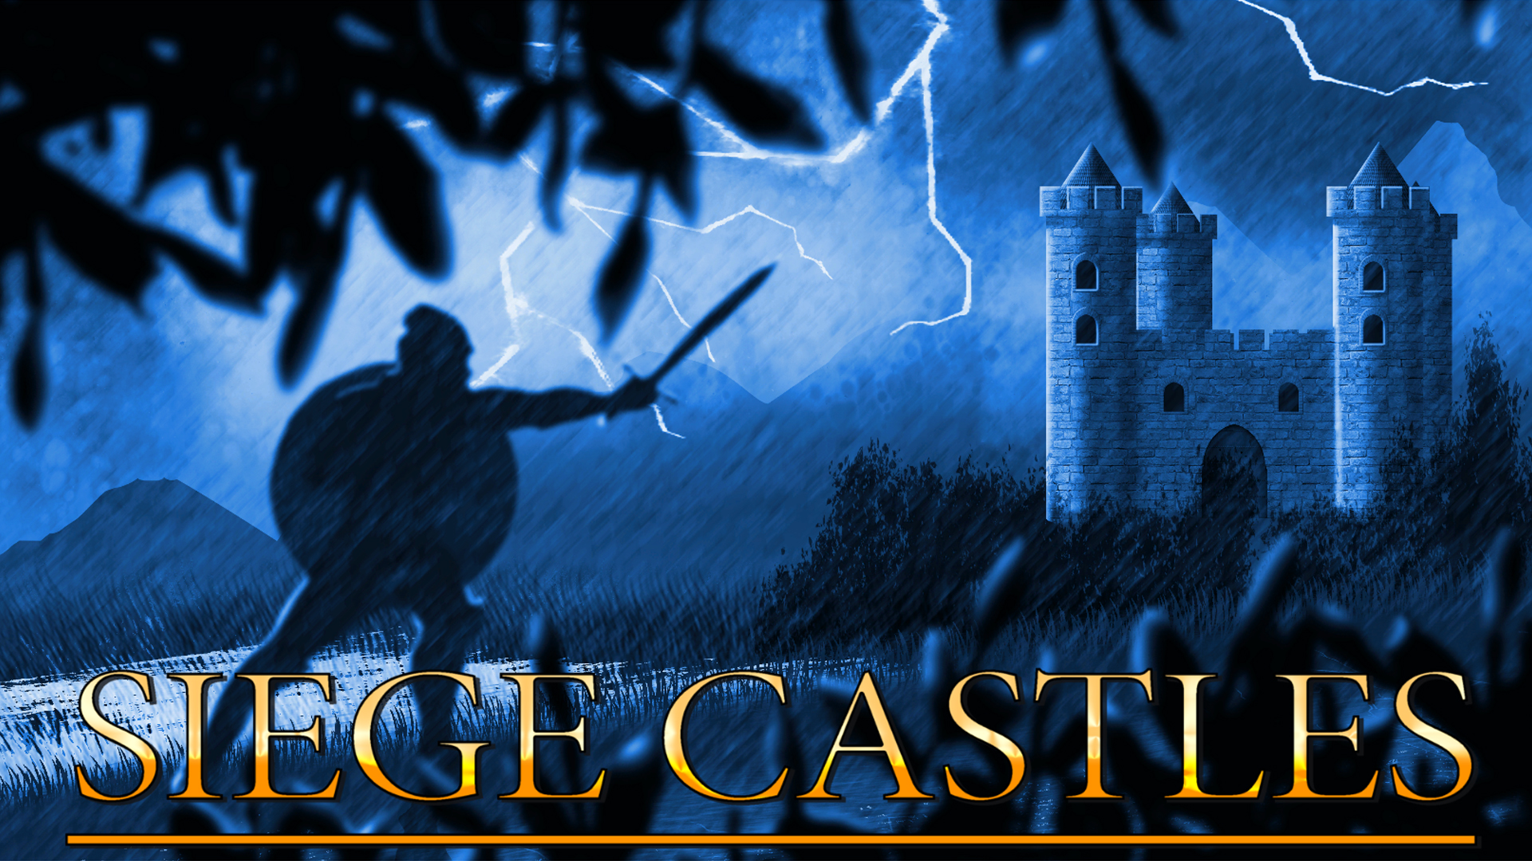
PHZ Game Studios
Jesse Honkanen
Lead Game Designer

Slide 2


Siege Castles is a Tactical Artillery game
Real time
Physics based
Castle vs Castle
Android & iOS
Early Access

Slide 3
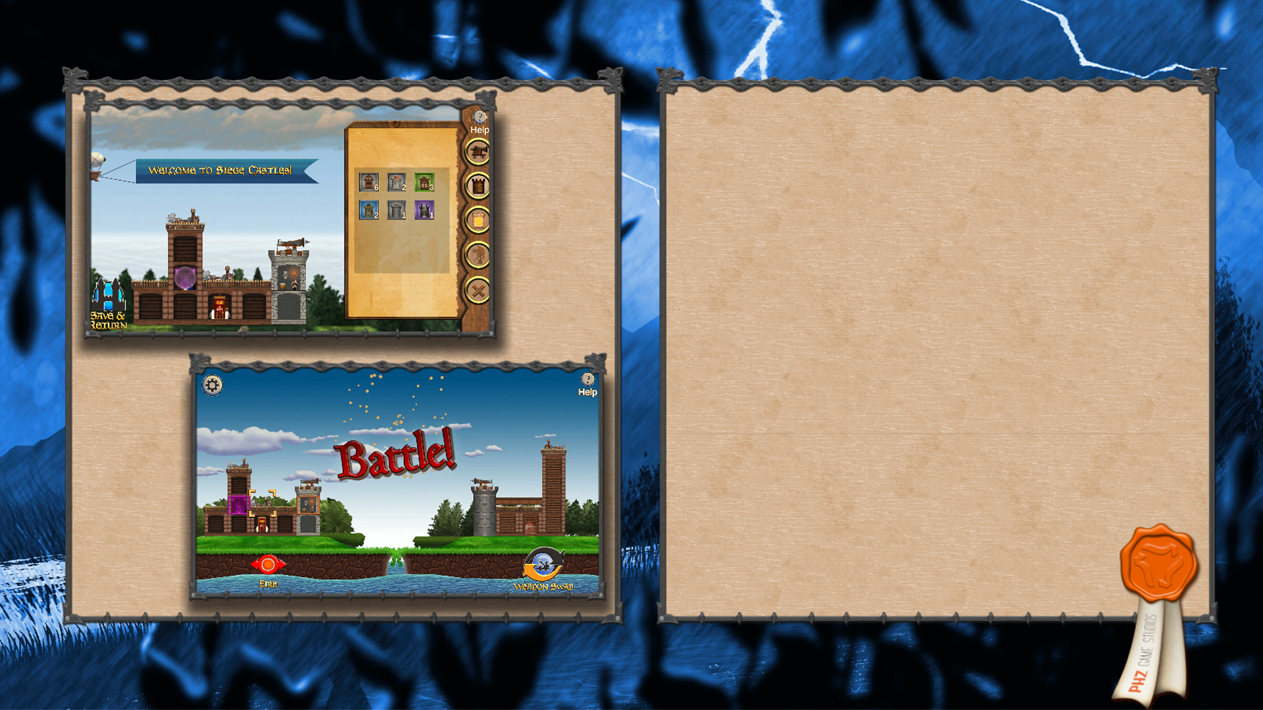
Game Loop
Design / Adjust
Intense Combat

Slide 4
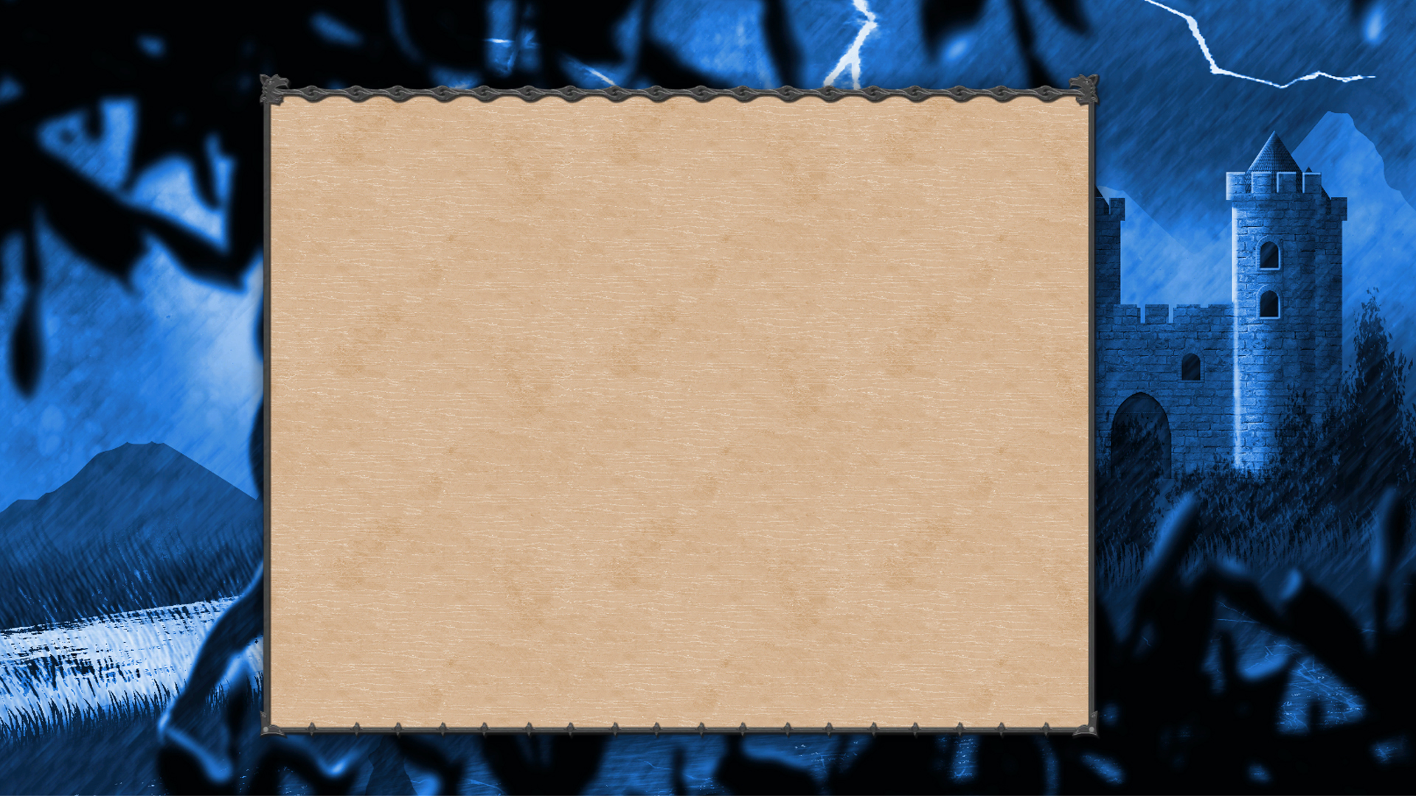
Customize your castle to suit your strategy
Expand your kingdom
Unlock new materials, spells, troops & siege weapons
Easy to learn, hard to master

Slide 5
  Flexible & Fair
Free to Play
Power Score for balanced matches
Paying customers get more options earlier and access to cosmetic customization

Slide 6

Steadily growing team
2 Programmers
2 Artists
1 Designer
Shared vision
Additional resources of PHZ Full Stack Oy

Slide 7
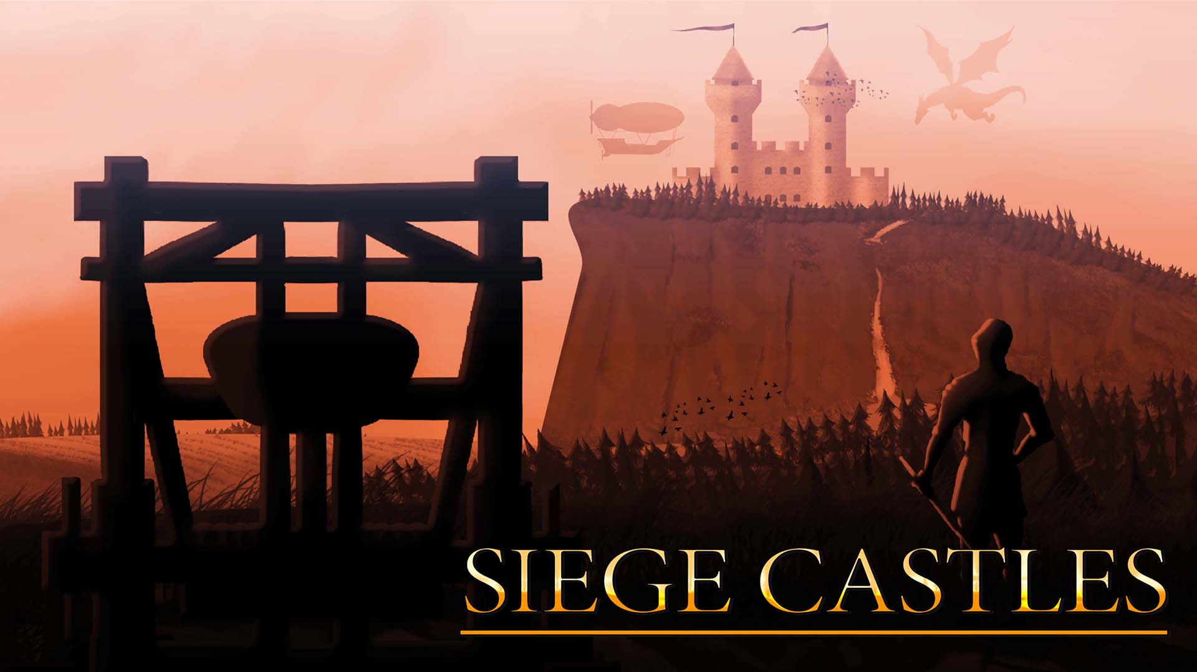
Thank you ! Forum 👉 https://gs.phz.fi
Email: jesse.honkanen@phz.fi

